Slide 1
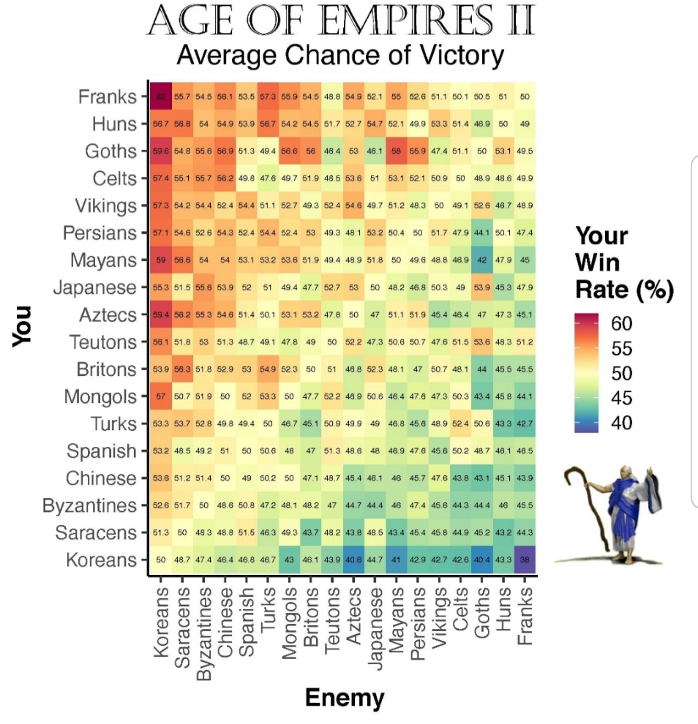

Slide 2
OPER 618 Lesson 05 Computing Solution Concepts for Normal Form Games
Dr. Brian J. Lunday
Office: Rm 201E, Bldg 641

Slide 3

Maximin
$$\begin{matrix}max & U_{1} & \\ s.t. & \sum_{j∈A_{1}}{u_{1}\left(a_{1}^{j},a_{2}^{k}\right)s_{1}^{j}}≥U_{1}, & ∀k∈A_{2}, \\ & \sum_{j∈A_{1}}{s_{1}^{j}}=1, & \\ & s_{1}^{j}≥0, & ∀j∈A_{1}.\end{matrix}$$

Slide 4

Minmax
$$\begin{matrix}min & U_{1} & \\ s.t. & \sum_{k∈A_{2}}{u_{1}\left(a_{1}^{j},a_{2}^{k}\right)s_{2}^{k}}≤U_{1}, & ∀ j∈A_{1}, \\ & \sum_{k∈A_{2}}{s_{2}^{k}}=1, & \\ & s_{2}^{k}≥0, & ∀ k∈A_{2}.\end{matrix}$$

Slide 5
Discussion Question
Do the maximin and the minmax solutions yield the same outcome?
If so, under what conditions?
If not, why not?

Slide 6

Minmax with Slack Variables
$$\begin{matrix}min & U_{1} & \\ s.t. & \sum_{k∈A_{2}}{u_{1}\left(a_{1}^{j},a_{2}^{k}\right)s_{2}^{k}}+r_{1}^{j}=U_{1}, & ∀ j∈A_{1}, \\ & \sum_{k∈A_{2}}{s_{2}^{k}}=1, & \\ & s_{2}^{k}≥0, & ∀ k∈A_{2}, \\ & r_{1}^{j}≥0, & ∀ j∈A_{1}.\end{matrix}$$

Slide 7

Linear Complementarity Problem
$$\begin{matrix}\sum_{k∈A_{2}}{u_{1}\left(a_{1}^{j},a_{2}^{k}\right)s_{2}^{k}}+r_{1}^{j}=U_{1}, & ∀ j∈A_{1}, \\ \sum_{j∈A_{1}}{u_{2}\left(a_{1}^{j},a_{2}^{k}\right)s_{1}^{j}}+r_{2}^{k}=U_{2}, & ∀ k∈A_{2}, \\ \sum_{j∈A_{1}}{s_{1}^{j}}=1 & \\ \sum_{k∈A_{2}}{s_{2}^{k}}=1, & \\ s_{1}^{j} r_{1}^{j}=0, & ∀ j∈A_{1}, \\ s_{2}^{k} r_{2}^{k}=0, & ∀ k∈A_{2}, \\ s_{1}^{j},r_{1}^{j}≥0, & ∀ j∈A_{1}, \\ s_{2}^{k},r_{2}^{k}≥0, & ∀ k∈A_{2}.\end{matrix}$$

Slide 8
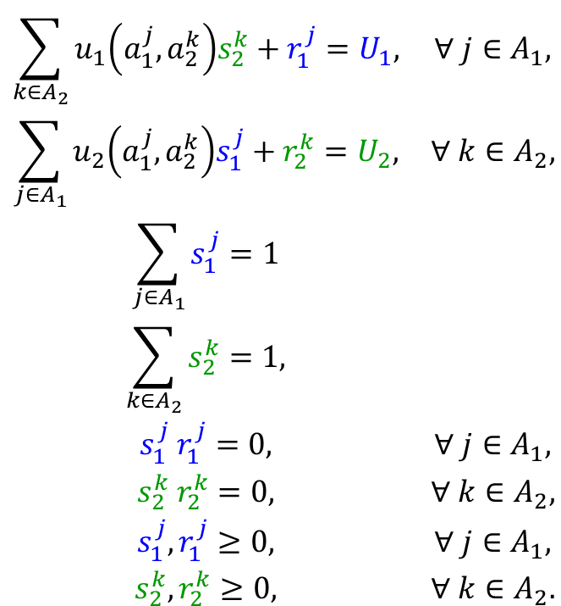
Class Discussion (1 of 4)
$$\begin{matrix}\sum_{k∈A_{2}}{u_{1}\left(a_{1}^{j},a_{2}^{k}\right)s_{2}^{k}}+r_{1}^{j}=U_{1}, & ∀ j∈A_{1}, \\ \sum_{j∈A_{1}}{u_{2}\left(a_{1}^{j},a_{2}^{k}\right)s_{1}^{j}}+r_{2}^{k}=U_{2}, & ∀ k∈A_{2}, \\ \sum_{j∈A_{1}}{s_{1}^{j}}=1 & \\ \sum_{k∈A_{2}}{s_{2}^{k}}=1, & \\ s_{1}^{j} r_{1}^{j}=0, & ∀ j∈A_{1}, \\ s_{2}^{k} r_{2}^{k}=0, & ∀ k∈A_{2}, \\ s_{1}^{j},r_{1}^{j}≥0, & ∀ j∈A_{1}, \\ s_{2}^{k},r_{2}^{k}≥0, & ∀ k∈A_{2}.\end{matrix}$$
What do the complementary conditions mean, in a practical sense?
How can we solve the LCP?
What is a complementary basis?
How does the Lemke-Howson algorithm exploit this structure?

Slide 9
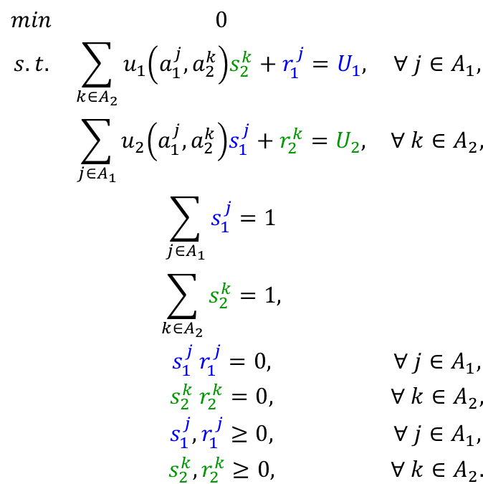
Class Discussion (2 of 4)
$$\begin{matrix}min & 0 & \\ s.t. & \sum_{k∈A_{2}}{u_{1}\left(a_{1}^{j},a_{2}^{k}\right)s_{2}^{k}}+r_{1}^{j}=U_{1}, & ∀ j∈A_{1}, \\ & \sum_{j∈A_{1}}{u_{2}\left(a_{1}^{j},a_{2}^{k}\right)s_{1}^{j}}+r_{2}^{k}=U_{2}, & ∀ k∈A_{2}, \\ & \sum_{j∈A_{1}}{s_{1}^{j}}=1 & \\ & \sum_{k∈A_{2}}{s_{2}^{k}}=1, & \\ & s_{1}^{j} r_{1}^{j}=0, & ∀ j∈A_{1}, \\ & s_{2}^{k} r_{2}^{k}=0, & ∀ k∈A_{2}, \\ & s_{1}^{j},r_{1}^{j}≥0, & ∀ j∈A_{1}, \\ & s_{2}^{k},r_{2}^{k}≥0, & ∀ k∈A_{2}.\end{matrix}$$
Are the nonlinear constraints convex functions?
What does this result portend for the solvers we can use?
Antigone, BARON, Counne, LINDOGlobal, SCIP
Why?

Slide 10
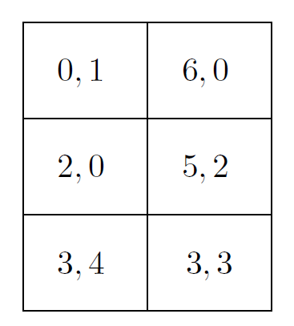
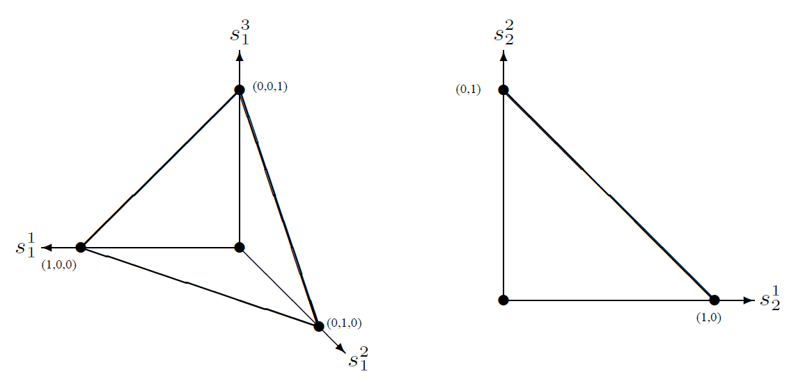





Lemke-Howson Algorithm Strategy Space Representation of NF Game
NF Game
$$a_{2}^{1}$$
$$a_{2}^{2}$$
$$a_{1}^{1}$$
$$a_{1}^{2}$$
$$a_{1}^{3}$$
Player 1 Strategy Space
Player 2 Strategy Space

Slide 11
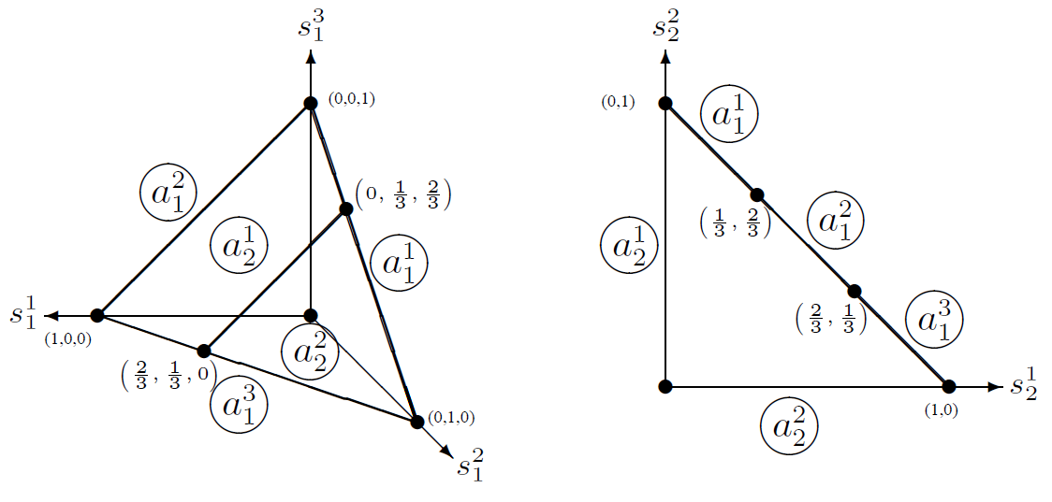




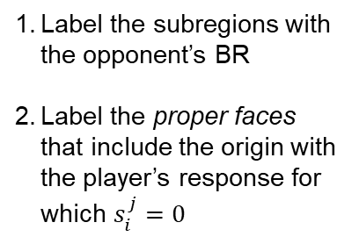

Lemke-Howson Algorithm Labelled Strategy Spaces
Strategy
Space Representation
$$a_{2}^{1}$$
$$a_{2}^{2}$$
$$a_{1}^{1}$$
$$a_{1}^{2}$$
$$a_{1}^{3}$$
Labelled Strategy Spaces
Label the subregions with the opponent’s BR
Label the proper faces that include the origin with the player’s response for which $s_{i}^{j}=0$

Slide 12
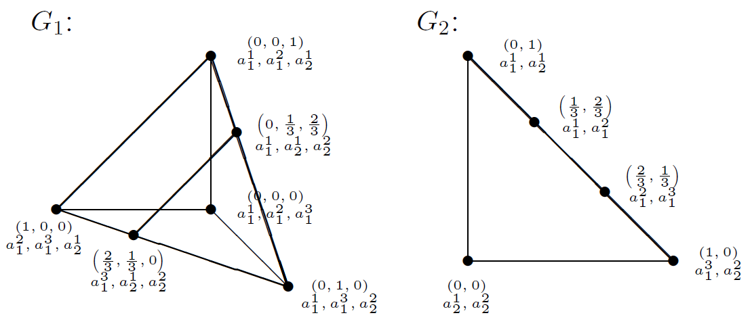
Lemke-Howson Algorithm Fully Labelled Strategy Spaces
Labelled Strategy Spaces
$$a_{2}^{1}$$
$$a_{2}^{2}$$
$$a_{1}^{1}$$
$$a_{1}^{2}$$
$$a_{1}^{3}$$
Fully Labelled Strategy Spaces

Slide 13
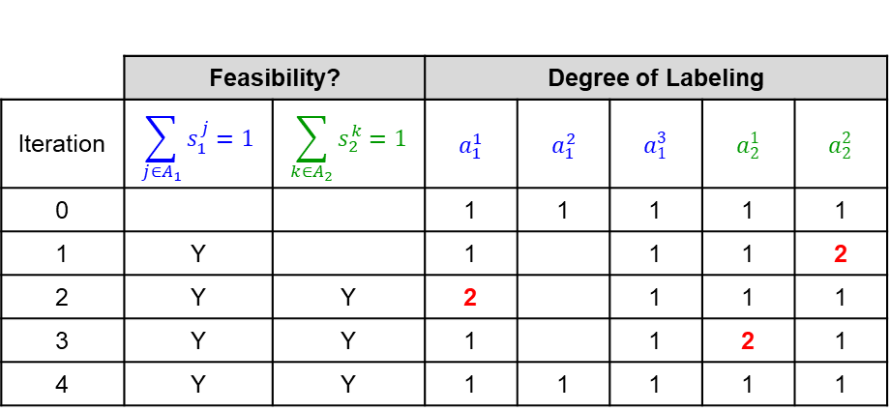
Lemke-Howson Algorithm Alternating Pivots, Searching for Completely Labelled Pair
Example from the Textbook
 | Feasibility? |  | Degree of Labeling
Iteration | $$\sum_{j∈A_{1}}{s_{1}^{j}}=1$$ | $$\sum_{k∈A_{2}}{s_{2}^{k}}=1$$ | $$a_{1}^{1}$$ | $$a_{1}^{2}$$ | $$a_{1}^{3}$$ | $$a_{2}^{1}$$ | $$a_{2}^{2}$$
0 |  |  | 1 | 1 | 1 | 1 | 1
1 | Y |  | 1 |  | 1 | 1 | 2
2 | Y | Y | 2 |  | 1 | 1 | 1
3 | Y | Y | 1 |  | 1 | 2 | 1
4 | Y | Y | 1 | 1 | 1 | 1 | 1

Slide 14
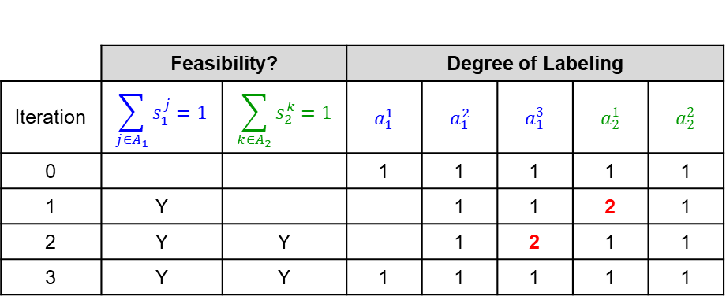
Lemke-Howson Algorithm Alternating Pivots, Searching for Completely Labelled Pair
Starting in a Different Initial Direction
 | Feasibility? |  | Degree of Labeling
Iteration | $$\sum_{j∈A_{1}}{s_{1}^{j}}=1$$ | $$\sum_{k∈A_{2}}{s_{2}^{k}}=1$$ | $$a_{1}^{1}$$ | $$a_{1}^{2}$$ | $$a_{1}^{3}$$ | $$a_{2}^{1}$$ | $$a_{2}^{2}$$
0 |  |  | 1 | 1 | 1 | 1 | 1
1 | Y |  |  | 1 | 1 | 2 | 1
2 | Y | Y |  | 1 | 2 | 1 | 1
3 | Y | Y | 1 | 1 | 1 | 1 | 1

Slide 15
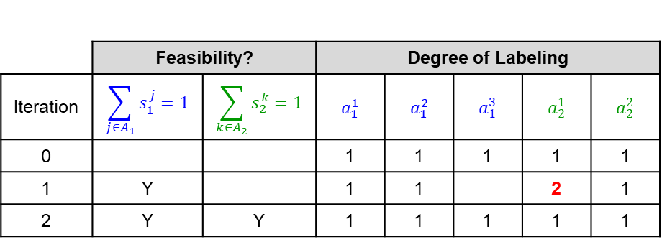
Lemke-Howson Algorithm Alternating Pivots, Searching for Completely Labelled Pair
Starting in yet Another, Different Initial Direction
 | Feasibility? |  | Degree of Labeling
Iteration | $$\sum_{j∈A_{1}}{s_{1}^{j}}=1$$ | $$\sum_{k∈A_{2}}{s_{2}^{k}}=1$$ | $$a_{1}^{1}$$ | $$a_{1}^{2}$$ | $$a_{1}^{3}$$ | $$a_{2}^{1}$$ | $$a_{2}^{2}$$
0 |  |  | 1 | 1 | 1 | 1 | 1
1 | Y |  | 1 | 1 |  | 2 | 1
2 | Y | Y | 1 | 1 | 1 | 1 | 1

Slide 16
Lemke-Howson Algorithm The Set of Completely Labelled Pairs
Nash Equilibria
Can the Lemke-Howson algorithm find all 3 Nash Equilibria? Why or why not?

Slide 17
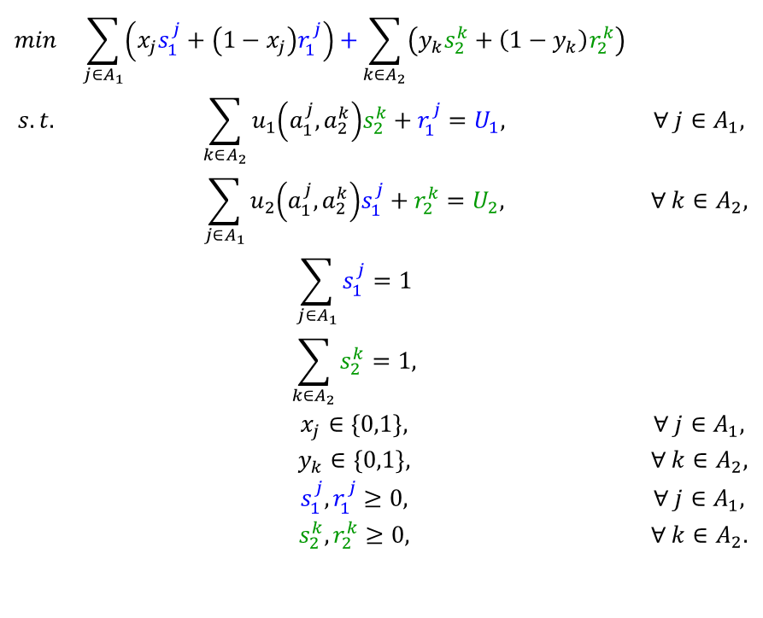
Class Discussion (3 of 4)
$$\begin{matrix}min & \sum_{j∈A_{1}}{\left(x_{j}s_{1}^{j}+\left(1−x_{j}\right)r_{1}^{j}\right)+}\sum_{k∈A_{2}}{\left(y_{k}s_{2}^{k}+\left(1−y_{k}\right)r_{2}^{k}\right)} & \\ s.t. & \sum_{k∈A_{2}}{u_{1}\left(a_{1}^{j},a_{2}^{k}\right)s_{2}^{k}}+r_{1}^{j}=U_{1}, & ∀ j∈A_{1}, \\ & \sum_{j∈A_{1}}{u_{2}\left(a_{1}^{j},a_{2}^{k}\right)s_{1}^{j}}+r_{2}^{k}=U_{2}, & ∀ k∈A_{2}, \\ & \sum_{j∈A_{1}}{s_{1}^{j}}=1 & \\ & \sum_{k∈A_{2}}{s_{2}^{k}}=1, & \\ & x_{j}∈\left\{0,1\right\}, & ∀ j∈A_{1}, \\ & y_{k}∈\left\{0,1\right\}, & ∀ k∈A_{2}, \\ & s_{1}^{j},r_{1}^{j}≥0, & ∀ j∈A_{1}, \\ & s_{2}^{k},r_{2}^{k}≥0, & ∀ k∈A_{2}.\end{matrix}$$
How would you classify this formulation?
What commercial solvers can we use now?

Slide 18

Class Discussion (4 of 4)
$$\begin{matrix}min & \sum_{j∈A_{1}}{\left(x_{j}s_{1}^{j}+\left(1−x_{j}\right)r_{1}^{j}\right)+}\sum_{k∈A_{2}}{\left(y_{k}s_{2}^{k}+\left(1−y_{k}\right)r_{2}^{k}\right)} & \\ s.t. & \sum_{k∈A_{2}}{u_{1}\left(a_{1}^{j},a_{2}^{k}\right)s_{2}^{k}}+r_{1}^{j}=U_{1}, & ∀ j∈A_{1}, \\ & \sum_{j∈A_{1}}{u_{2}\left(a_{1}^{j},a_{2}^{k}\right)s_{1}^{j}}+r_{2}^{k}=U_{2}, & ∀ k∈A_{2}, \\ & \sum_{j∈A_{1}}{s_{1}^{j}}=1 & \\ & \sum_{k∈A_{2}}{s_{2}^{k}}=1, & \\ & 0≤x_{j}≤1, & ∀ j∈A_{1}, \\ & 0≤y_{k}≤1, & ∀ k∈A_{2}, \\ & s_{1}^{j},r_{1}^{j}≥0, & ∀ j∈A_{1}, \\ & s_{2}^{k},r_{2}^{k}≥0, & ∀ k∈A_{2}.\end{matrix}$$
Is the relaxation of binary restrictions acceptable?
Why or why not?

Slide 19
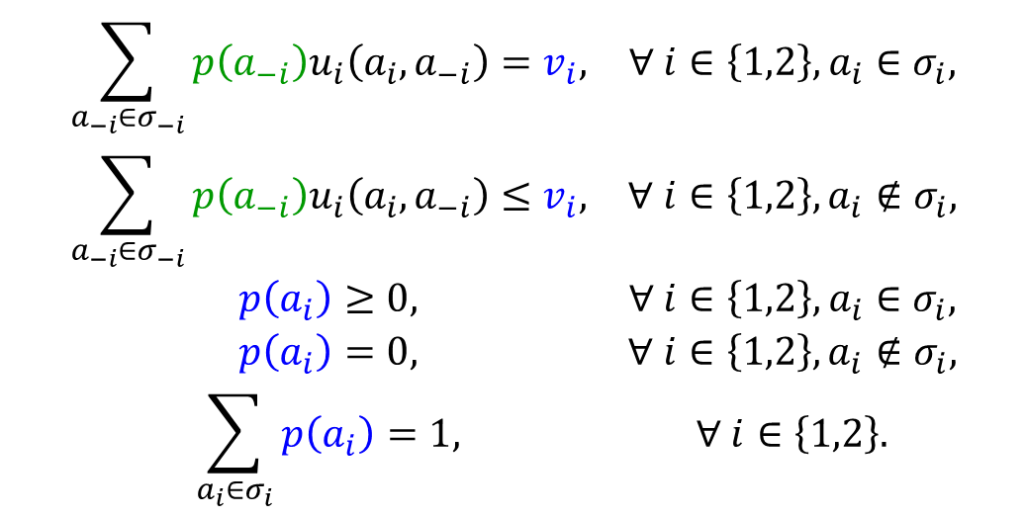
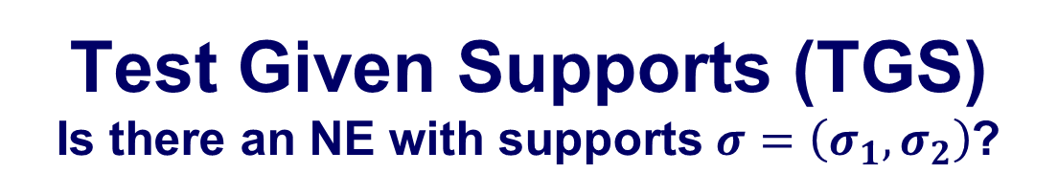
Test Given Supports (TGS) Is there an NE with supports $σ=\left(σ_{1},σ_{2}\right)$?
$$\begin{matrix}\sum_{a_{−i}∈σ_{−i}}{p\left(a_{−i}\right)u_{i}\left(a_{i},a_{−i}\right)}=v_{i}, & ∀ i∈\left\{1,2\right\}, a_{i}∈σ_{i}, \\ \sum_{a_{−i}∈σ_{−i}}{p\left(a_{−i}\right)u_{i}\left(a_{i},a_{−i}\right)}≤v_{i}, & ∀ i∈\left\{1,2\right\}, a_{i}∉σ_{i}, \\ p\left(a_{i}\right)≥0, & ∀ i∈\left\{1,2\right\}, a_{i}∈σ_{i}, \\ p\left(a_{i}\right)=0, & ∀ i∈\left\{1,2\right\}, a_{i}∉σ_{i}, \\ \sum_{a_{i}∈σ_{i}}{p\left(a_{i}\right)}=1, & ∀ i∈\left\{1,2\right\}.\end{matrix}$$
Opponent strategy creates indifference among supports
With no preference for other supports
Only non-zero weights for supports of interest
Complete strategies

Slide 20
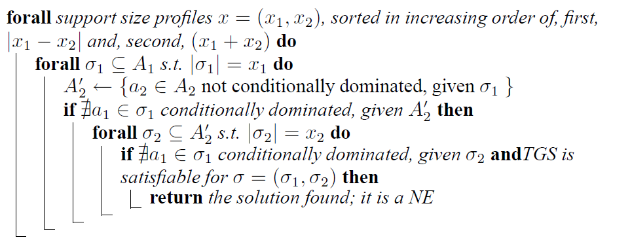
Heuristic Search for NE Support Enumeration Method (SEM)
What is the importance of the metrics for ordering the outer loop?
What is conditional domination?
Will this heuristic find all Nash equilibria?
If so, why is it called a heuristic?
If not, why not?

Slide 21







Beyond NE Computation (Not all NE are Equally Desirable)
Nash Equilibria
NF Game
$$a_{2}^{1}$$
$$a_{2}^{2}$$
$$a_{1}^{1}$$
$$a_{1}^{2}$$
$$a_{1}^{3}$$
$$\left(0, 2/3,1/3\right)$$
NE Payoffs
$$\left(u_{1},u_{2}\right)=\left(3,4\right)$$
How would you discriminate among the multiple NE?
$$\left(u_{1},u_{2}\right)=\left(4,0.67\right)$$
$$\left(u_{1},u_{2}\right)=\left(3,2.67\right)$$

Slide 22
Questions & Discussion

